Slide 1
Computer Organization تنظيم الحاسوب
Chapter 3
Dr. Mahmoud Masadeh

Slide 2
Arithmetic for Computers

Slide 3
3.1 Introduction
Computer words are composed of bits; thus, words can be represented as binary numbers.
The goal of this chapter is to explain:
representation of real numbers
arithmetic algorithms
hardware that follows these algorithms
and the implications of all this for instruction sets

Slide 4
3.2 Addition and Subtraction
To command

Slide 5
Addition and Subtraction
Overflow occurs when the result from an operation cannot be represented with the available hardware, in this case a 64-bit word.
When adding operands with different signs, overflow cannot occur.
how do we detect overflow when it does occur?
When an overflow occurs, the sign bit is set with the value of the result instead of the proper sign of the result.
Overflow conditions for addition and subtraction

Slide 6
Addition and Subtraction
Unsigned integers are commonly used for memory addresses where overflows are ignored.
The computer designer must decide how to handle arithmetic overflows.
Some languages, like C and Java, ignore integer overflow.
languages like Ada and Fortran require that the program be notified.
The programmer or the programming environment must then decide what to do when an overflow occurs.

Slide 7
3.3 Multiplication
The first operand is called the multiplicand and the second the multiplier. The final result is called the product.
For n-bit multiplicand and m-bit multiplier, the result is n + m bits long.
The goal is to provide the highly optimized multiply hardware.

Slide 8
Sequential Version of the Multiplication Algorithm and Hardware
The multiplier is in the 64-bit Multiplier register and that the 128-bit Product register is initialized to 0.
We need to move the multiplicand left one digit each step, as it may be added to the intermediate products.
We need a 128-bit Multiplicand register. Why??
0
00
000

Slide 9
Sequential Version of the Multiplication Algorithm and Hardware
Multiplier0
These three steps are repeated 64 times to obtain the product.
If each step took a clock cycle, this algorithm would require almost 200 clock cycles to multiply two 64-bit numbers.

Slide 10
Multiply example

Slide 11
Refined Version of the Multiplication Algorithm and Hardware
This algorithm and hardware are refined to take one clock cycle per step.
Thus, perform the operations in parallel
The multiplier and multiplicand are shifted while the multiplicand is added to the product if the multiplier bit is a 1.
The hardware just has to ensure that it tests the right bit of the multiplier and gets the preshifted version of the multiplicand.
HI
LO
The hardware is usually further optimized to halve the
width of the adder and registers by noticing where there
are unused portions of registers and adders.

Slide 12
Multiply example
Consider: 1100 × 1101 , Product = 1001 1100 (12 x 13=156)
4-bit multiplicand and multiplier are used in this example
4-bit adder produces a 5-bit sum (with carry)

Slide 13
Signed Multiplication
So far, we have dealt with unsigned integer multiplication
First Attempt:
Convert multiplier and multiplicand into positive numbers
If negative, then obtain the 2's complement and remember the sign
Perform unsigned multiplication
Compute the sign of the product
If product sign < 0 then obtain the 2's complement of theproduct
Better Version:
Use the unsigned multiplication hardware
When shifting right, extend the sign of the product
If multiplier is negative, the last step should be a subtract

Slide 14
Signed Multiplication (Pencil & Paper)
Case 1: Positive Multiplier
Multiplicand 1100 = - 4
Multiplier × 0101 = +5
11111100
111100
Product 11101100 = - 20
Case 2: Negative Multiplier
Multiplicand 1100 = - 4
Multiplier × 1101 = - 3
11111100
111100
00100 (2's complement of 1100)
Product 00001100 = +12

Slide 15
Signed Multiplication (Pencil & Paper)
Consider: 1100 (-4) × 1101 (-3), Product = 00001100
Check for overflow: No overflow → Extend sign bit
Last iteration: add 2's complement of Multiplicand

Slide 16
Faster Multiplication
The multiplicand is known at the beginning of the multiplication by looking at each of the 64 multiplier bits.
Faster multiplications are possible by providing one 64-bit adder for each bit of the multiplier: one input is the multiplicand ANDed with a multiplier bit, and the other is the output of a prior adder.
We should connect the outputs of adders on the right to the inputs of adders on the left, making a stack of adders 64 high.
An alternative way to organize these 64
additions is in a parallel tree. Instead of
waiting for 64 add times, we wait just
the log₂ (64) or six 64-bit add times.

Slide 17
Faster Multiplication

Slide 18
Faster Multiplication
Uses Multiple Adders (Cost vs. Performance)
Rather than use a single 64-bit adder 63 times, this hardware “unrolls the loop” to use 63 adders and then organizes them to minimize delay.
Can be pipelined

Slide 19
Multiply in RISC-V
To produce a properly signed or unsigned 128-bit product, RISC-V has four instructions:
multiply (mul)
multiply high (mulh)
multiply high unsigned (mulhu)
multiply high signed-unsigned (mulhsu)
To get the integer 64-bit product, the programmer uses mul.
To get the upper 64 bits of the 128-bit product, the programmer uses
(mulh) if both operands are signed,
(mulhu) if both operands are unsigned,
(mulhsu) if one operand is signed and the other is unsigned.

Slide 20
Multiply - Summary
Multiplication hardware simply shifts and adds, as derived from the paper-and pencil method learned in grammar school.
Compilers even use shift instructions for multiplications by powers of 2.
With much more hardware we can do the adds in parallel, and do them much faster.

Slide 21
3.4 Unsigned Division (Paper & Pencil)
الناتج
المقسوم عليه
المقسوم
الباقي

Slide 22
A Division Algorithm and Hardware
We start with the 64-bit Quotient register set to 0.
Each iteration of the algorithm needs to move the divisor to the right one digit.
We start with the divisor placed in the left half of the 128-bit Divisor register and shift it right 1 bit each step to align it with the dividend.
The Remainder register is initialized with the dividend.
The computer isn’t smart enough to know in advance whether the divisor is smaller than the dividend.
Initially divisor in left half
HI
LO
Initially dividend

Slide 23
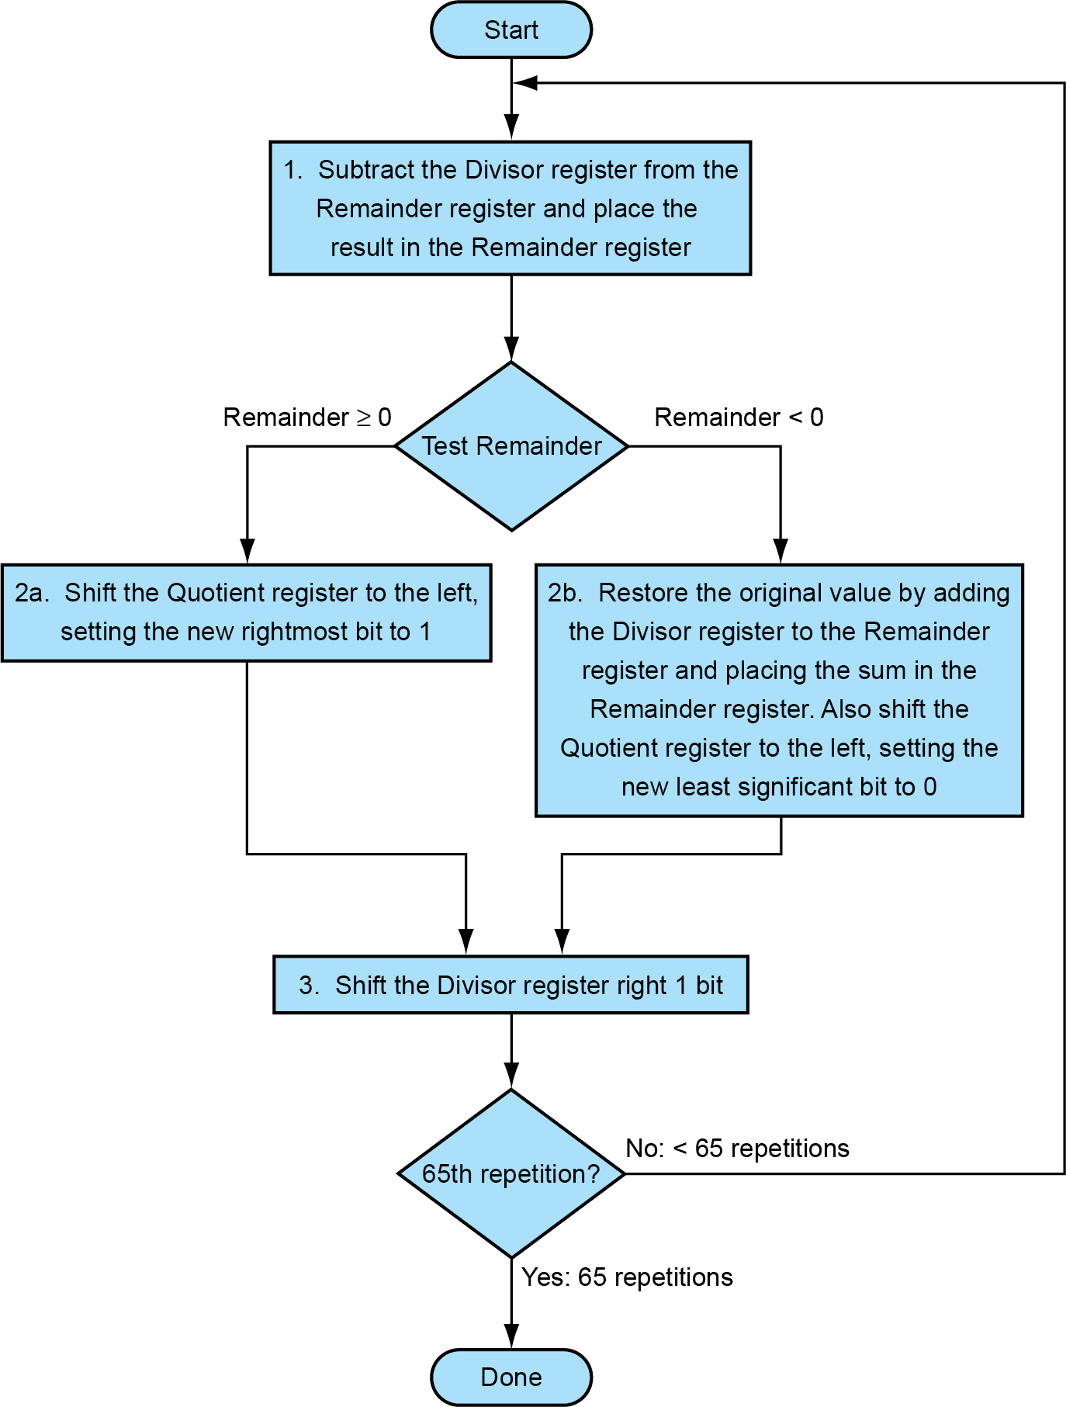
A Division Algorithm and Hardware
Initially divisor in left half
Remainder← Remainder -Divisor
Remainder← Remainder + Divisor
SL(Quotient) with LSB=0
SL(Quotient) with LSB=1
SR(Divisor)
Initially dividend

Slide 24
A Division Algorithm and Hardware
Remainder← Remainder -Divisor
Using a 4-bit version of the algorithm, let’s try dividing 7ten by 2ten, or 0000 0111two by 0010two.
Remainder← Remainder + Divisor
SL(Quotient) with LSB=0
SL(Quotient) with LSB=1
SR(Divisor)

Slide 25
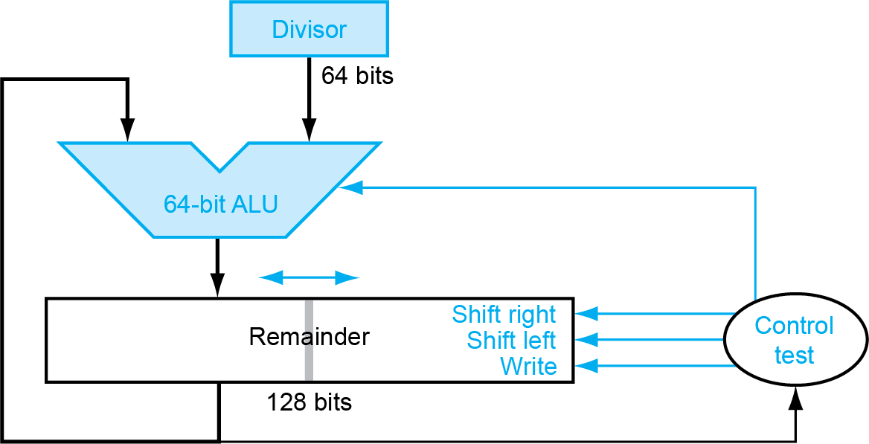
An improved version of the division hardware.
This algorithm and hardware can be refined to be faster and cheaper.
The speedup comes from shifting the operands and the quotient simultaneously with the subtraction.
This refinement halves the width of the adder and registers by noticing where there are unused portions of registers and adders.

Slide 26
Signed Division
So far, we have ignored signed numbers in division.
The simplest solution is to remember the signs of the divisor and dividend.
Do the unsigned division
Compute the signs of the quotient and remainder
Quotient sign = Dividend sign XOR Divisor sign
Remainder sign = Dividend sign

Slide 27
Signed Division Example
Positive Dividend and Positive Divisor
Example: +17 / +3 Quotient = +5 Remainder = +2
Positive Dividend and Negative Divisor
Example: +17 / –3 Quotient = –5 Remainder = +2
Negative Dividend and Positive Divisor
Example: –17 / +3 Quotient = –5 Remainder = –2
Negative Dividend and Negative Divisor
Example: –17 / –3 Quotient = +5 Remainder = –2
The following equation must always hold:
Dividend = Quotient × Divisor + Remainder

Slide 28
Faster Division
There are techniques to produce more than one bit of the quotient per step.
The SRT (Sweeney, Robertson, and Tocher) division technique tries to predict several quotient bits per step, using a table lookup based on the upper bits of the dividend and remainder.
The accuracy of this fast method depends on having proper values in the lookup table.

Slide 29
Divide in RISC-V
We observed that the same sequential hardware can be used for both multiply and divide.
The only requirement is a 128-bit register that can shift left or right and a 64-bit ALU that adds or subtracts.
To handle both signed integers and unsigned integers, RISC-V has two instructions for division and two instructions for remainder:
Divide (div)
Divide unsigned (divu)
Remainder (rem)
Remainder unsigned (remu)

Slide 32
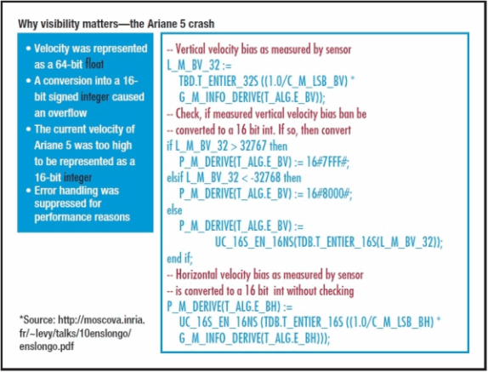
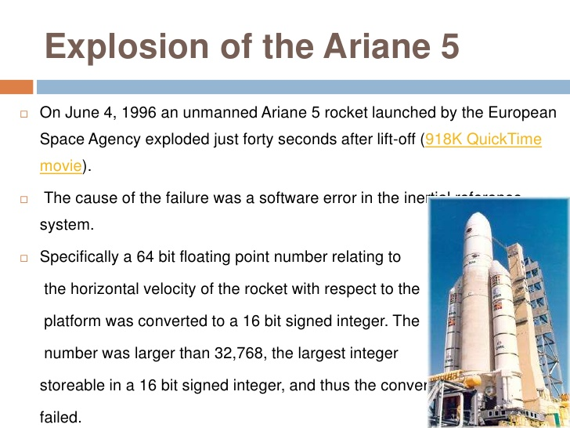
3.5 Floating Point
A space error:
370.000.000 $ for an integer overflow

Slide 33
3.5 Floating Point
Going beyond signed and unsigned integers, programming languages support numbers with fractions, which are called reals in mathematics.
Here are some examples of reals:
Scientific notation: A notation that renders numbers with a single digit to the left of the decimal point.
Normalized: A number in floating-point notation that has no leading 0s.
For example, 1.0_{ten} × 10⁻⁹ is in normalized scientific notation, but 0.1_{ten} × 10⁻⁸ and 10.0_{ten} × 10⁻¹⁰ are not.
Floating point: Computer arithmetic that represents numbers in which the binary point is not fixed.
Numbers are represented as a single nonzero digit to the left of the binary point.
In binary, the form is 1.xxxxxxxxx_{two} 2^{yyyy}

Slide 34
Floating Point
Defined by IEEE Std 754-1985
A standard scientific notation for reals in the normalized form offers three advantages:
It simplifies exchange of data that includes floating-point numbers
it simplifies the floating-point arithmetic algorithms to know that numbers will always be in this form;
it increases the accuracy of the numbers that can be stored in a word, since real digits to the right of the binary point replace the unnecessary leading 0s

Slide 35
Floating-Point Representation
A designer of a floating-point representation must find a compromise between the size of the fraction and the size of the exponent
This tradeoff is between precision and range:
increasing the size of the fraction enhances the precision of the fraction,
1.xx → 1.00 / 1.01 / 1.10/ 1.11
1.x → 1.0 / 1.1
increasing the size of the exponent increases the range of numbers that can be represented.
fraction The value, generally between 0 and 1, placed in the fraction field. The fraction is also called the mantissa.
exponent In the numerical representation system of floating-point arithmetic, the value that is placed in the exponent field.

Slide 36
Floating-Point Representation
Floating-point numbers are usually a multiple of the size of a word.
The representation of a RISC-V floating-point number is shown below, where s is the sign of the floating-point number (1 meaning negative), exponent is the value of the 8-bit exponent field (including the sign of the exponent), and fraction is the 23-bit number.
This representation is sign and magnitude, since the sign is a separate bit from the rest of the number.

Slide 37
Floating-Point Representation
F involves the value in the fraction field
E involves the value in the exponent field
Overflow (floatingpoint): A situation in which a positive exponent becomes too large to fit in the exponent field.
Underflow (floatingpoint) A situation in which a negative exponent becomes too large to fit in the exponent field.
Single precision A floating-point value represented in a 32-bit word.
Double precision A floating-point value represented in a 64-bit doubleword.

Slide 38
Exceptions and Interrupts
When an overflow or underflow occurs, some computers signal these events by raising an exception, sometimes called an interrupt.
An exception or interrupt is essentially an unscheduled procedure call.
RISC-V computers do not raise an exception on overflow or underflow.
Software can read the Floating-point Control and Status Register (fcsr) to check whether overflow or underflow has occurred

Slide 39
IEEE 754 Floating-Point Format
single: 8 bits double: 11 bits
single: 23 bits double: 52 bits
S
Exponent
Fraction
S: sign bit (0 ⇒ non-negative, 1 ⇒ negative)
Normalize significand: 1.0 ≤ |significand| < 2.0
Always has a leading pre-binary-point 1 bit, so no need to represent it explicitly (hidden bit)
Significand is Fraction with the “1.” restored
Exponent: excess representation: actual exponent + Bias
Ensures exponent is unsigned
Single: Bias = 127; Double: Bias = 1203
Biasing is done because exponents have to be signed values in order to be able to represent both tiny and huge values

Slide 40
Single-Precision Range
Exponents 00000000 and 11111111 reserved
Smallest value
Exponent: 00000001 ⇒ actual exponent = 1 – 127 = –126
Fraction: 000…00 ⇒ significand = 1.0
±1.0 × 2^{–126} ≈ ±1.2 × 10^{–38}
Largest value
exponent: 11111110 ⇒ actual exponent = 254 – 127 = +127
Fraction: 111…11 ⇒ significand ≈ 2.0
±2.0 × 2⁺¹²⁷ ≈ ±3.4 × 10⁺³⁸

Slide 41
Single-Precision Examples

Slide 42
Double-Precision Range
Exponents 0000…00 and 1111…11 reserved
Smallest value
Exponent: 00000000001 ⇒ actual exponent = 1 – 1023 = –1022
Fraction: 000…00 ⇒ significand = 1.0
±1.0 × 2^{–1022} ≈ ±2.2 × 10^{–308}
Largest value
Exponent: 11111111110 ⇒ actual exponent = 2046 – 1023 = +1023
Fraction: 111…11 ⇒ significand ≈ 2.0
±2.0 × 2⁺¹⁰²³ ≈ ±1.8 × 10⁺³⁰⁸

Slide 43
Floating-Point Example
Represent –0.75
–0.75 = (–1)¹ × 1.1₂ × 2^{–1}
S = 1
Fraction = 1000…00₂
Exponent –Bias= -1
Single: –1 + 127 = 126 = 01111110₂ (126 -127 = -1 → Exponent=126)
Double: –1 + 1023 = 1022 = 01111111110₂
Single: 1011111101000…00
Double: 1011111111101000…00

Slide 44
Floating-Point Example
What number is represented by the single-precision float
11000000101000…00
S = 1
Fraction = 01000…00₂
Fxponent = 10000001₂ = 129
x = (–1)¹ × (1 + 01₂) × 2^{(129 – 127)}
= (–1) × 1.25 × 2²
= –5.0

Slide 45
De-normal/Sub-normal Numbers
A normalized number is a number for which both the exponent (including bias) and the most significant bit of the mantissa are non-zero
Exponent = 000...0 ⇒ hidden bit is 0
Smaller than normal numbers
allow for gradual underflow, with diminishing precision
Denormal with fraction = 000...0
Single: 10000000000011..00
Exponent is Zero→ denormalized function
- (0.0011 x 2 ^{-127 →}001.1 x 2 ⁻¹³¹
Two representations of 0.0!

Slide 46
De-normal/Sub-normal Numbers
The smallest positive single precision normalized number is
The smallest single precision denormalized number is

Slide 47
Infinities and NaNs
Exponent = 111...1, Fraction = 000...0
±Infinity
Can be used in subsequent calculations, avoiding need for overflow check
Exponent = 111...1, Fraction ≠ 000...0
Not-a-Number (NaN)
Indicates illegal or undefined result
e.g., 0.0 / 0.0
Can be used in subsequent calculations

Slide 48
IEEE Encoding of Floating-Point Numbers

Slide 49
Floating-Point Addition
Consider a 4-digit decimal example
9.999 × 10¹ + 1.610 × 10^{–1}
Align decimal points
Shift number with smaller exponent
9.999 × 10¹ + 0.016 × 10¹
Add significands
9.999 × 10¹ + 0.016 × 10¹ = 10.015 × 10¹
Normalize result & check for over/underflow
1.0015 × 10²
Round and renormalize if necessary
1.002 × 10²

Slide 50
Floating-Point Addition
Now consider a 4-digit binary example
1.000₂ × 2^{–1} + –1.110₂ × 2^{–2} (0.5 + –0.4375)
Align binary points
Shift number with smaller exponent
1.000₂ × 2^{–1} + –0.111₂ × 2^{–1}
Add significands
1.000₂ × 2^{–1} + –0.111₂ × 2^{–1} = 0.001₂ × 2^{–1}
Normalize result & check for over/underflow
1.000₂ × 2^{–4}, with no over/underflow
Round and renormalize if necessary
1.000₂ × 2^{–4} (no change) = 0.0625

Slide 51
Floating-Point Addition

Slide 52
FP Adder Hardware
Much more complex than integer adder
Doing it in one clock cycle would take too long
Much longer than integer operations
Slower clock would penalize all instructions
FP adder usually takes several cycles
Can be pipelined

Slide 53
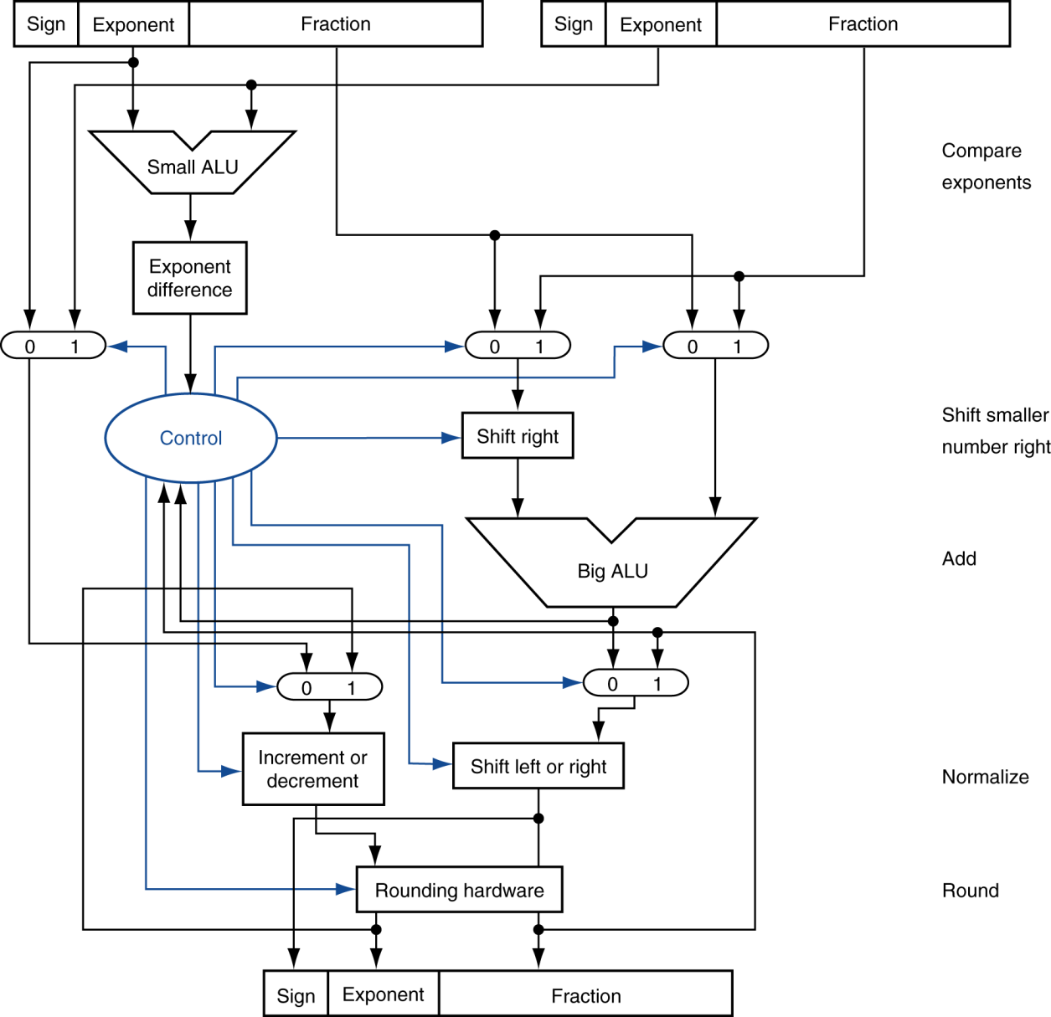
FP Adder Hardware
Step 1
Step 2
Step 3
Step 4

Slide 54
Floating-Point Multiplication
Consider a 4-digit decimal example
1.110 × 10¹⁰ × 9.200 × 10^{–5}
Add exponents
For biased exponents, subtract bias from sum
New exponent = 10 + –5 = 5
Multiply significands
1.110 × 9.200 = 10.212 ⇒ 10.212 × 10⁵
Normalize result & check for over/underflow
1.0212 × 10⁶
Round and renormalize if necessary
1.021 × 10⁶
Determine sign of result from signs of operands
+1.021 × 10⁶

Slide 55
Floating-Point Multiplication
Now consider a 4-digit binary example
1.000₂ × 2^{–1} × –1.110₂ × 2^{–2} (0.5 × –0.4375)
Add exponents
Unbiased: –1 + –2 = –3
Biased: (–1 + 127) + (–2 + 127) = –3 + 254 – 127 = –3 + 127
Multiply significands
1.000₂ × 1.110₂ = 1.1102 ⇒ 1.110₂ × 2^{–3}
Normalize result & check for over/underflow
1.110₂ × 2^{–3} (no change) with no over/underflow
Round and renormalize if necessary
1.110₂ × 2^{–3} (no change)
Determine sign: +ve × –ve ⇒ –ve
–1.110₂ × 2^{–3} = –0.21875

Slide 56
Floating-Point Multiplication

Slide 57
FP Arithmetic Hardware
FP multiplier is of similar complexity to FP adder
But uses a multiplier for significands instead of an adder
FP arithmetic hardware usually does
Addition, subtraction, multiplication, division, reciprocal, square-root
FP ↔ integer conversion
Operations usually takes several cycles
Can be pipelined

Slide 58
FP Instructions in RISC-V

Slide 59
FP Instructions in RISC-V
Separate FP registers: f0, …, f31
double-precision
single-precision values stored in the lower 32 bits
FP instructions operate only on FP registers
Programs generally don’t do integer ops on FP data, or vice versa
More registers with minimal code-size impact
FP load and store instructions
flw, fld
fsw, fsd

Slide 60
FP Instructions in RISC-V
Single-precision arithmetic
fadd.s, fsub.s, fmul.s, fdiv.s, fsqrt.s
e.g., fadds.s f2, f4, f6
Double-precision arithmetic
fadd.d, fsub.d, fmul.d, fdiv.d, fsqrt.d
e.g., fadd.d f2, f4, f6
Single- and double-precision comparison
feq.s, flt.s, fle.s
feq.d, flt.d, fle.d
Result is 0 or 1 in integer destination register
Use beq, bne to branch on comparison result
Branch on FP condition code true or false
B.cond

Slide 61
FP Example: °F to °C
C code:
float f2c (float fahr) { return ((5.0/9.0)*(fahr - 32.0)); }
fahr in f10, result in f10, literals in global memory space
Compiled RISC-V code:
f2c:
flw f0,const5(x3) // f0 = 5.0f
flw f1,const9(x3) // f1 = 9.0f
fdiv.s f0, f0, f1 // f0 = 5.0f / 9.0f
flw f1,const32(x3) // f1 = 32.0f
fsub.s f10,f10,f1 // f10 = fahr – 32.0
fmul.s f10,f0,f10 // f10 = (5.0f/9.0f) * (fahr–32.0f)
jalr x0,0(x1) // return

Slide 62
FP Example: Array Multiplication
C = C + A × B
All 32 × 32 matrices, 64-bit double-precision elements
C code:
void mm (double c[][], double a[][], double b[][]) { size_t i, j, k; for (i = 0; i < 32; i = i + 1) for (j = 0; j < 32; j = j + 1) for (k = 0; k < 32; k = k + 1) c[i][j] = c[i][j] + a[i][k] * b[k][j]; }
Addresses of c, a, b in x10, x11, x12, and i, j, k in x5, x6, x7

Slide 63
FP Example: Array Multiplication
RISC-V code:
mm:...
li x28,32 // x28 = 32 (row size/loop end)
li x5,0 // i = 0; initialize 1st for loop
L1: li x6,0 // j = 0; initialize 2nd for loop
L2: li x7,0 // k = 0; initialize 3rd for loop
slli x30,x5,5 // x30 = i * 2**5 (size of row of c)
add x30,x30,x6 // x30 = i * size(row) + j
slli x30,x30,3 // x30 = byte offset of [i][j]
add x30,x10,x30 // x30 = byte address of c[i][j]
fld f0,0(x30) // f0 = c[i][j]
L3: slli x29,x7,5 // x29 = k * 2**5 (size of row of b)
add x29,x29,x6 // x29 = k * size(row) + j
slli x29,x29,3 // x29 = byte offset of [k][j]
add x29,x12,x29 // x29 = byte address of b[k][j]
fld f1,0(x29) // f1 = b[k][j]

Slide 64
FP Example: Array Multiplication
…
slli x29,x5,5 // x29 = i * 2**5 (size of row of a)
add x29,x29,x7 // x29 = i * size(row) + k
slli x29,x29,3 // x29 = byte offset of [i][k]
add x29,x11,x29 // x29 = byte address of a[i][k]
fld f2,0(x29) // f2 = a[i][k]
fmul.d f1, f2, f1 // f1 = a[i][k] * b[k][j]
fadd.d f0, f0, f1 // f0 = c[i][j] + a[i][k] * b[k][j]
addi x7,x7,1 // k = k + 1
bltu x7,x28,L3 // if (k < 32) go to L3
fsd f0,0(x30) // c[i][j] = f0
addi x6,x6,1 // j = j + 1
bltu x6,x28,L2 // if (j < 32) go to L2
addi x5,x5,1 // i = i + 1
bltu x5,x28,L1 // if (i < 32) go to L1

Slide 65
Elaboration
Another reason for separate integers and floating-point registers is that microprocessors in the 1980s didn’t have enough transistors to put the floating-point unit on the same chip as the integer unit.
Hence, the floating-point unit, including the floating-point registers, was optionally available as a second chip.
Such optional accelerator chips are called coprocessor chips.
Since the early 1990s, microprocessors have integrated floating point (and just about everything else) on chip.

Slide 66

IEEE 754 Floating-Point Format
With 8-bit exponent represented in 2’s complement, comparison should be easy, But:
1111 1111 is -1 (large binary number)
0000 0001 is +1 (small binary number)
The desired notation must have
All 0’s for the most negative number
All 1’s for the most positive number
This convention is called biased notation, with the bias being the number subtracted from the normal, unsigned representation to determine the real value.

Slide 67
IEEE Rounding
Floating point numbers are approximations of real numbers.
Rounding is the process of removing the extra bits with the digital system resulting from internal computation with higher precision than the exact bus width.
Thus, exact results should be computed and then rounded to the nearest floating-point number using the ‘round to nearest - even’ approach.
But in practice, with limited precision hardware resources, it is impossible to compute exact results.
So, two guard bits (G and R) and a third bit, sticky (S), are introduced to ensure the computation results within an acceptable accuracy using minimum overhead.
Notes:
https://www.youtube.com/watch?v=bmL7kDQkE_w&ab_channel=GATEBOOKVIDEOLECTURES

Slide 68
IEEE Rounding
The default rounding mode specified by the IEEE 754 standard is round to nearest - even.
It can be seen from the table that the average bias (which is the average of the sum of errors for all cases) for the round to nearest scheme is zero.
Rounding is done only if condition R.(M0 +S) is true (Boolean).
Notes:
https://www.youtube.com/watch?v=bmL7kDQkE_w&ab_channel=GATEBOOKVIDEOLECTURES

Slide 69
IEEE Rounding
The default rounding mode specified by the IEEE 754 standard is round to nearest - even.
Notes:
https://www.youtube.com/watch?v=bmL7kDQkE_w&ab_channel=GATEBOOKVIDEOLECTURES

Slide 70
Rounding with Guard Digits
Notes:
https://www.youtube.com/watch?v=bmL7kDQkE_w&ab_channel=GATEBOOKVIDEOLECTURES

Slide 71
Accurate Arithmetic
IEEE Std 754 specifies additional rounding control
Extra bits of precision (guard, round, sticky)
Choice of rounding modes
Allows programmer to fine-tune numerical behavior of a computation
1.1101 10000 → 1.1110
1.1110 11000 → 1.1111
1.1110 01000 →1.1110
Not all FP units implement all options
Most programming languages and FP libraries just use defaults
Trade-off between hardware complexity, performance, and market requirements
Notes:
https://www.youtube.com/watch?v=bmL7kDQkE_w&ab_channel=GATEBOOKVIDEOLECTURES

Slide 72
Subword Parallellism
Graphics and audio applications can take advantage of performing simultaneous operations on short vectors
Example: 128-bit adder:
Sixteen 8-bit adds
Eight 16-bit adds
Four 32-bit adds
Also called data-level parallelism, vector parallelism, or Single Instruction, Multiple Data (SIMD)

